Slide 1
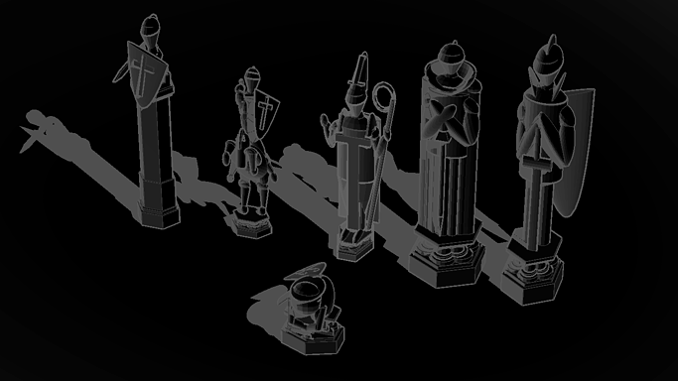

Wizards’ Chess
Group 21

Slide 2

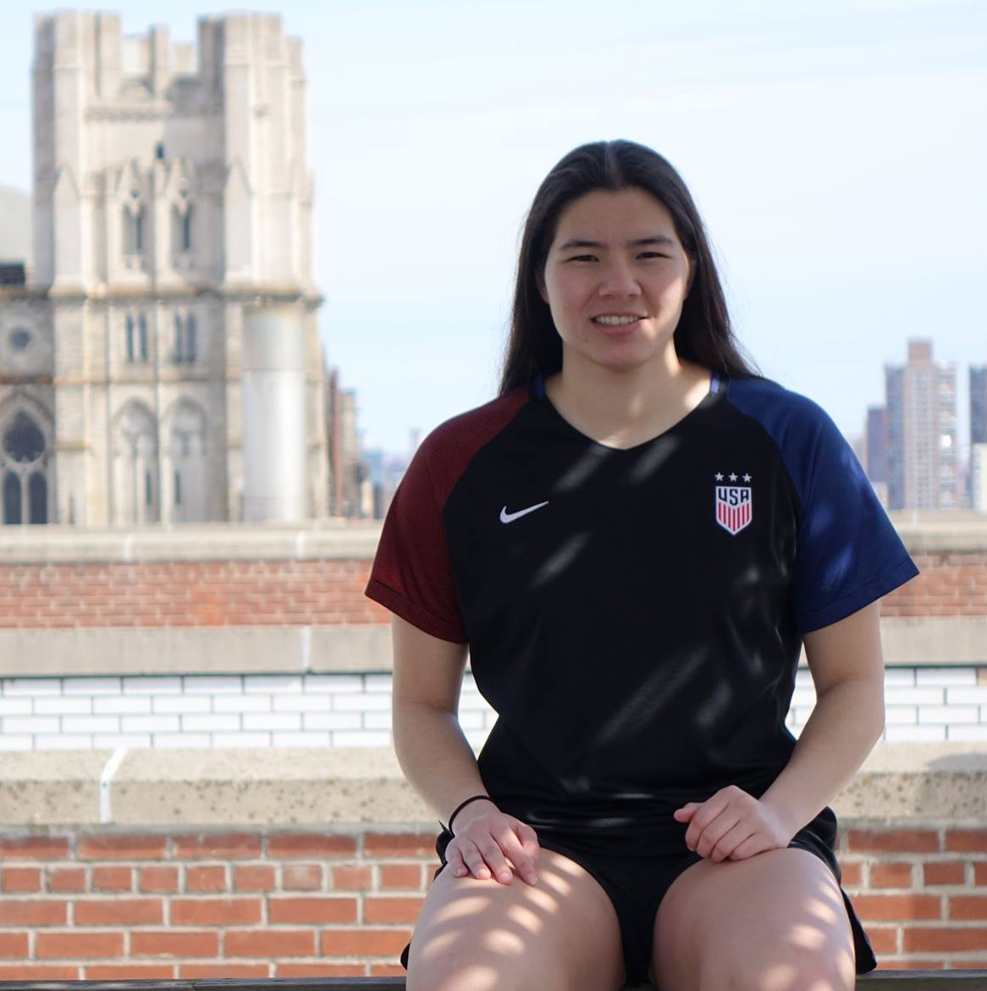






Meet the Team
Niharika Shukla
MAE ‘21
Kirsten Scheller
ECE ‘21
Joy Thean
ECE ‘21
Vaishnavi Dhulkhed
ECE ‘21

Slide 3
Our Wizards’ Chess magically moves chess pieces through voice command
Just like the chess board in Harry Potter, our chess game listens for speech-recognized chess commands and moves the pieces accordingly.
The board is set up “double decker” style, with a mechanical arm underneath and a chessboard on top of it.
In our implementation, we used Python to store all the game details and then send data to the Arduino for movement implementation.

Slide 4
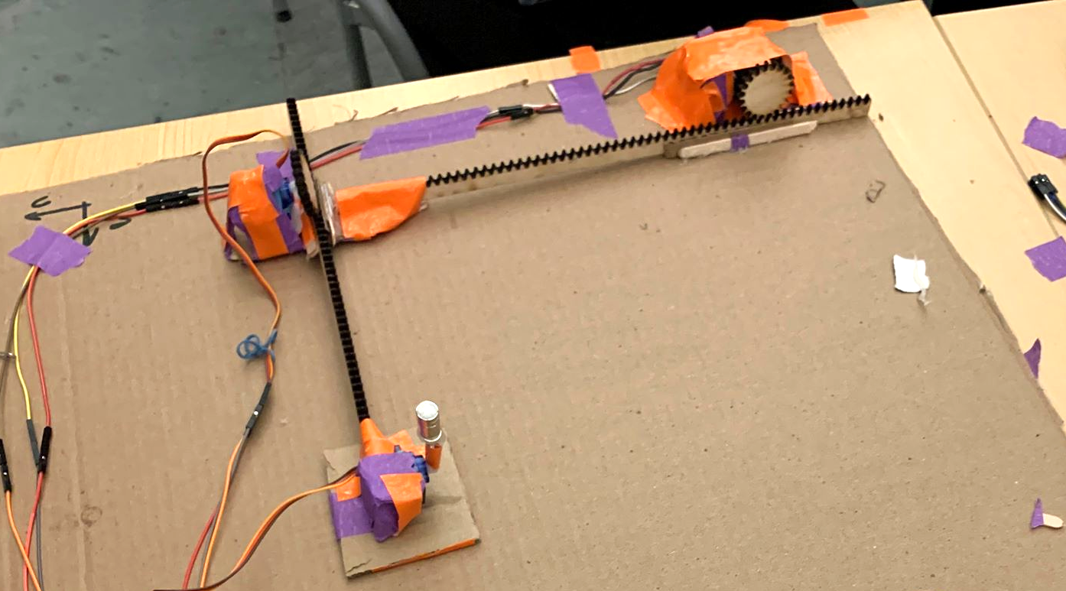
Our mechanical arm under the board controls pieces magnetically
Arm uses two laser cut gear rack-and-pinion system for motion with two degrees of freedom
A third servo adds a third degree of motion in the z-direction.

Slide 5
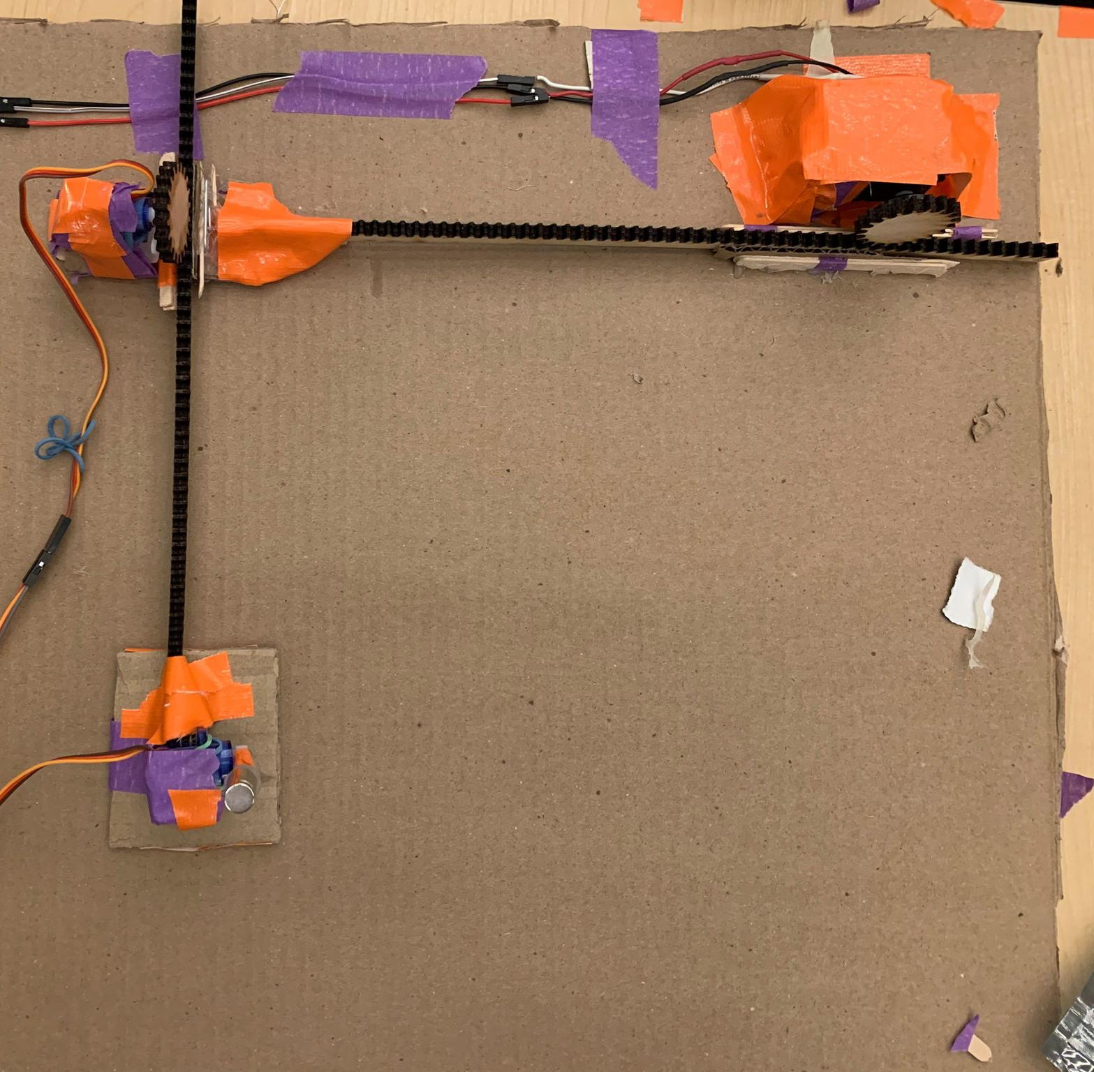
We use two continuous rotation servos for moving pieces up and down the board and one micro servo with a magnet to attach to the piece being moved

Slide 6
We use python and arduino serially to control the arm
Arduino
Listens for serial input from Python
Uses servos to move both horizontally and vertically, accordingly
Python
Stores 2D array of board coordinate system and pieces
Prompts user and listens for speech with adequate error checking and responds to user’s inputs (both visually and audibly)
Sends data about movement to Arduino via serial port

Slide 7
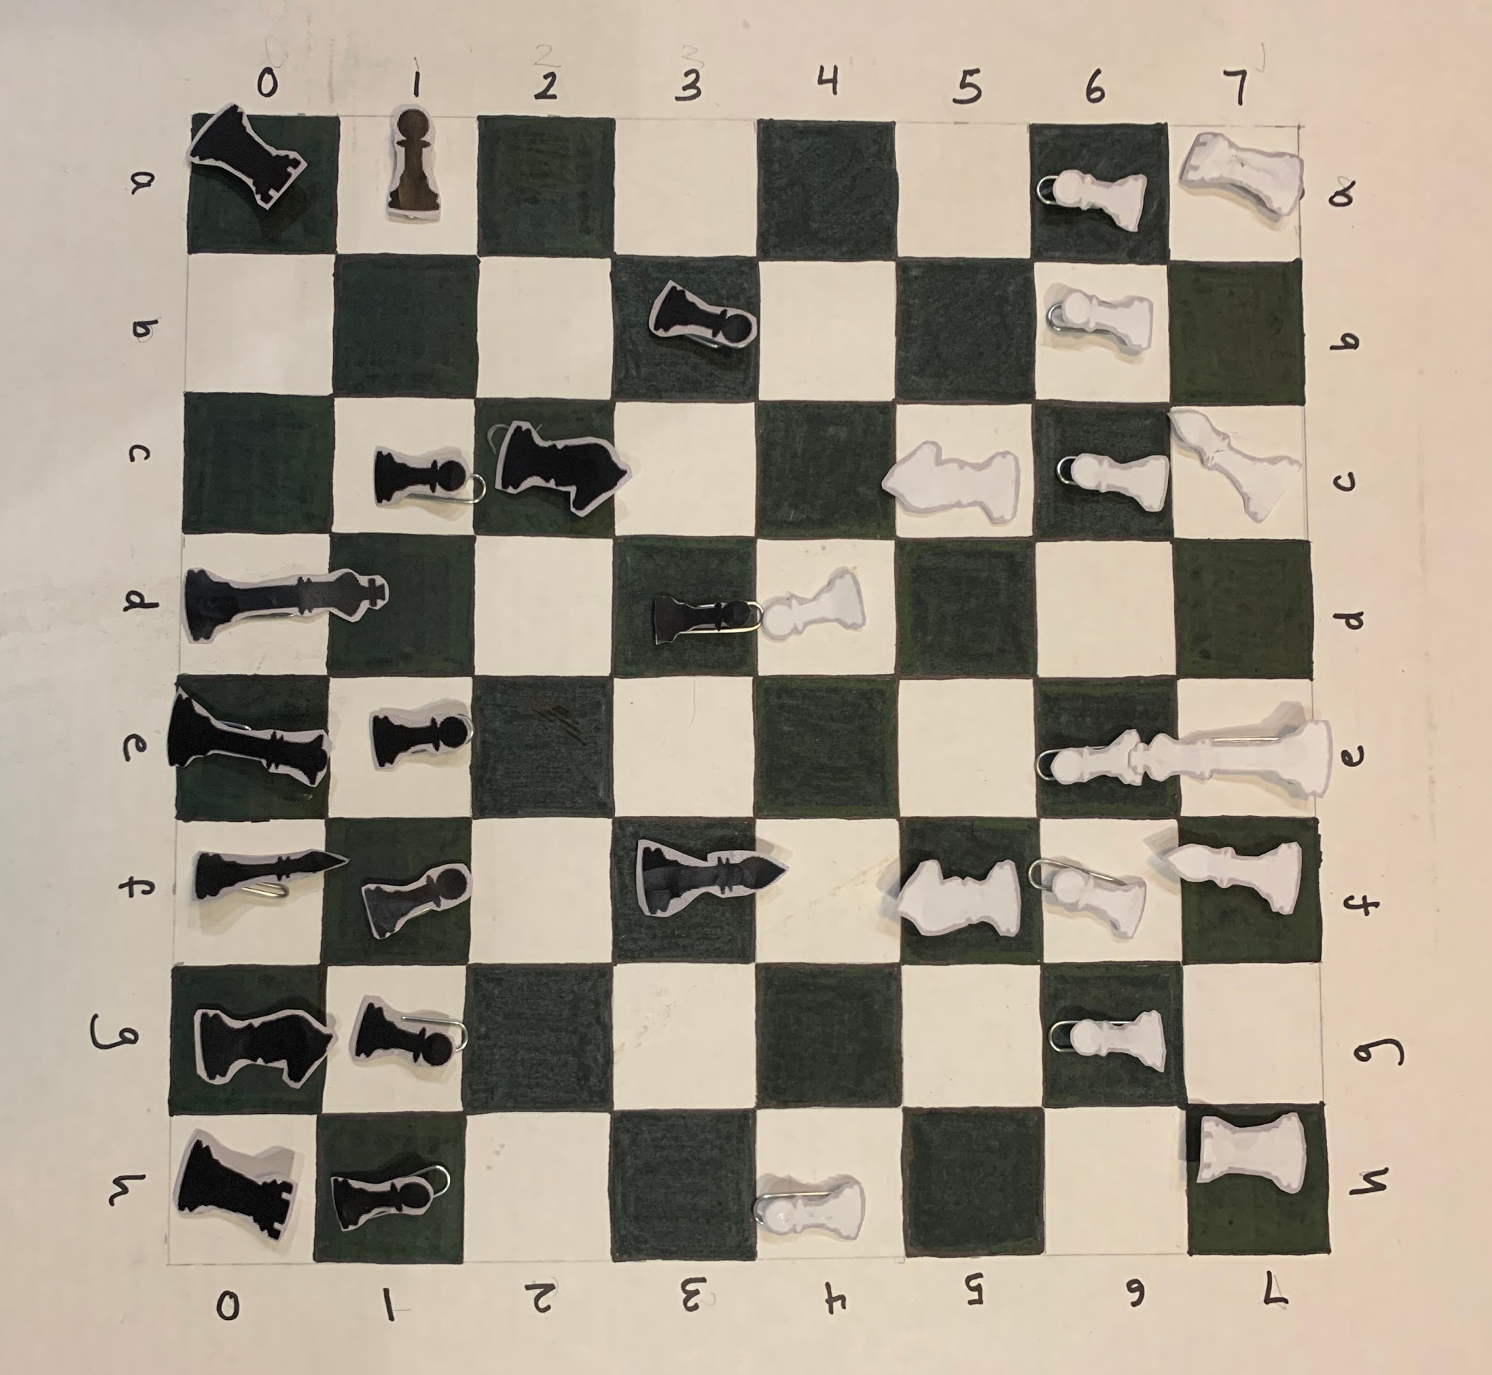
Our game allows visually or physically impaired to play a game of chess without having to actually move pieces.
The computer prompts and re-prompts based on user input and audibly calls out the state of the game.

Slide 8
Next Steps
Coding logic for capturing opponent pieces and what that would physically look like
Optimize path of knight piece (avoiding other pieces in the L path)
Get actual pieces with a strong magnetic base
More testing for smoother piece movements

Slide 9
Thank you to Cornell Maker Club and all volunteers!

